Slide 1
Dual-force convolutional neural networks for accurate brain tumor segmentation
Shengcong Chen, Changxing Ding, Minfeng Liu
2018

Slide 2
Introduction
Median Survival Time of High-Grade Gliomas patients is less than 2 years
Median Survival Time of glioblastoma patients is 4.9 months
Magnetic Resonance Imaging (MRI) is widely used for diagnosis and treatment of brain tumors
MRIs are large-volume 3D scans
  manual segmentation is time-consuming and tedious
  manual segmentation is likely to be affected by raters’ personal experience
designing an accurate brain tumor segmentation system is a challenging problem
  shape and internal structures of tumors are varied and complicated
  surrounding normal tissues are also in a wide variety of appearance due to variable locations of tumors and the so-called tumor mass effect
  boundaries between normal tissues and tumor tissues tend to be obscure and therefore they are difficult to differentiate
State-of-the-art dense prediction networks include DeepMedic and U-Net

Slide 3
Introduction
DeepMedic
  utilizes feature maps extracted from the final convolutional layer to predict the labels of voxels within the central regions of input patches efficiently
  final convolutional layer in CNN usually focuses on extracting high-level semantic information. The lack of low- and middle-level information restricts the performance of DeepMedic
U-Net
  They consist of an encoding network with down-sampling operations and a de-coding network with up-sampling or deconvolutional operations
  U-Nets introduce feature maps in the encoding network to the de-coding network through successive concatenation operations in order to introduce multi-level information gradually and finally promote the prediction accuracy

Slide 4
Introduction
a series of approaches to enhance the quality of the learnt features
  extend the popular DeepMedic model to Multi-Level DeepMedic to make use of multi-level information for more accurate segmentation
  a novel dual-force training scheme to promote the quality of multi-level features learnt from deep models. It is a general training scheme and can be applied to many exiting architectures, e.g., DeepMedic and U-Net
  design a label distribution-based loss function as an auxiliary classifier to encourage the high-level layers of deep models to learn more abstract information
  a novel Multi-Layer Perceptron-based post-processing approach to refine the prediction results of deep models

Slide 5
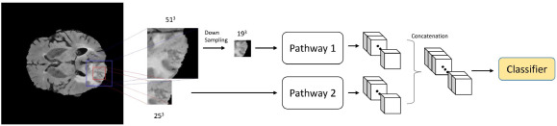
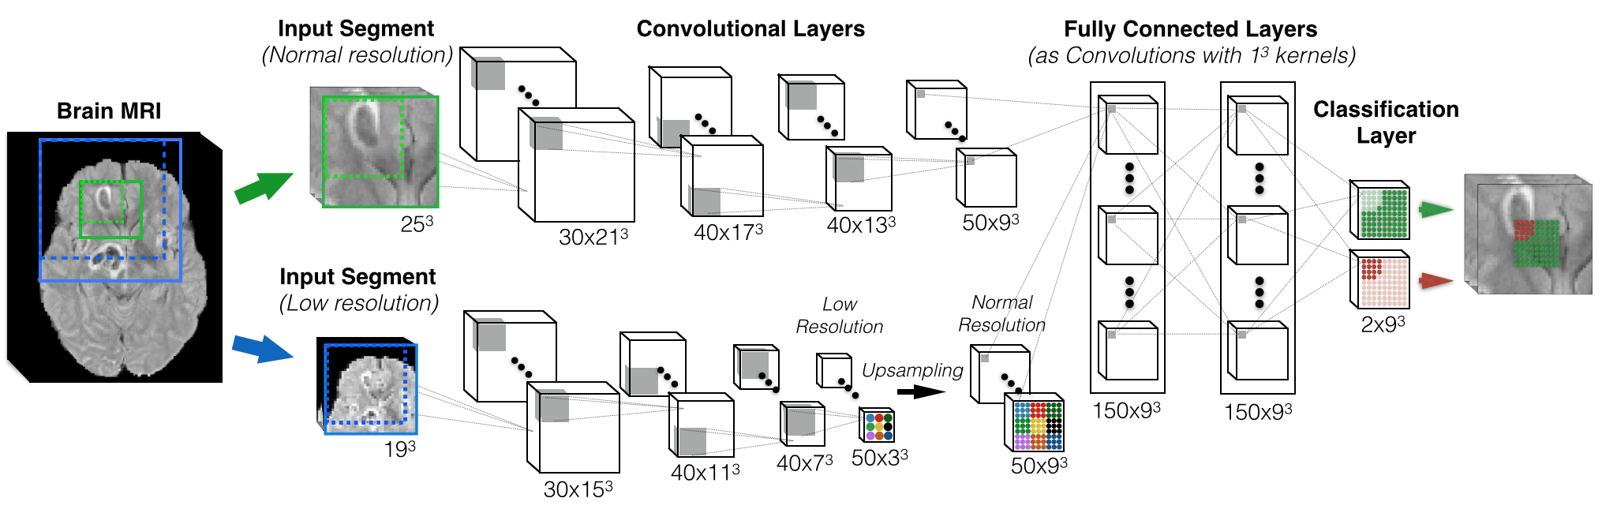
DeepMedic

Slide 6
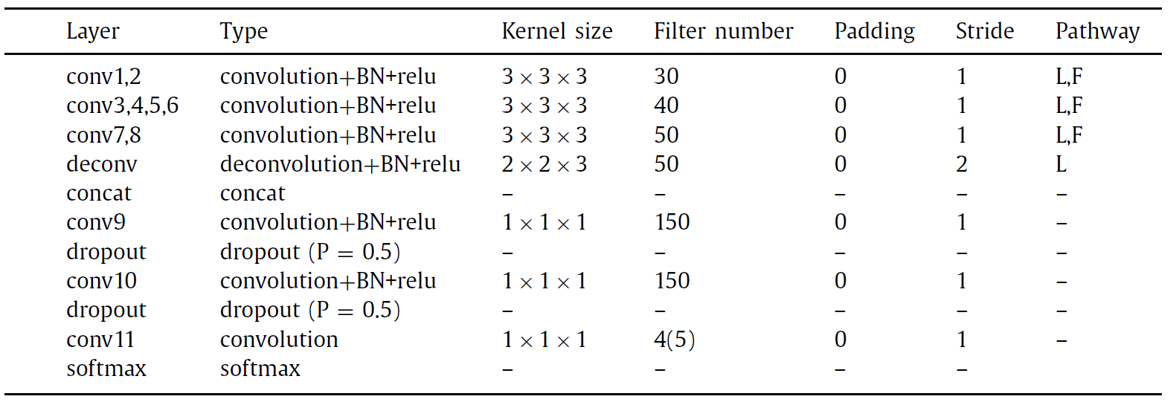
DeepMedic
For simplicity, only the full-resolution pathway of DeepMedic is shown. Each Conv block in the figure refers to the combination of one convolutional layer, one batch normalization layer and one ReLU layer.

Slide 7
Multi-level DeepMedic
Feature map patches are cropped from five selected layers and then concatenated to compose multi-level features. several crop layers to extract multi-level features of the same size, i.e., 9 ×9 ×9 from five selected layers of DeepMedic. Each crop layer crops a 3D patch from the center region of the feature map. To fuse these multi-level information, the cropped feature map patches are first concatenated and then fed into three successive 1 ×1 ×1 convolutional layers for final prediction.

Slide 8
U-Net
U-Net comprises an encoding network and a decoding network.
  In encoding network, stacked convolutional layers are followed by pooling layers to compress the size of feature maps and extract high-level semantic information.
  The decoding network incorporates a set of deconvolutional layers for resolution recovery. Moreover, feature maps generated by deconvolutional layers are concatenated with those produced by convolutional layers of the encoding network with the same resolution. The combination of feature maps enables U-Net to gradually fuse multi-level information for accurate brain tumor segmentation.

Slide 9
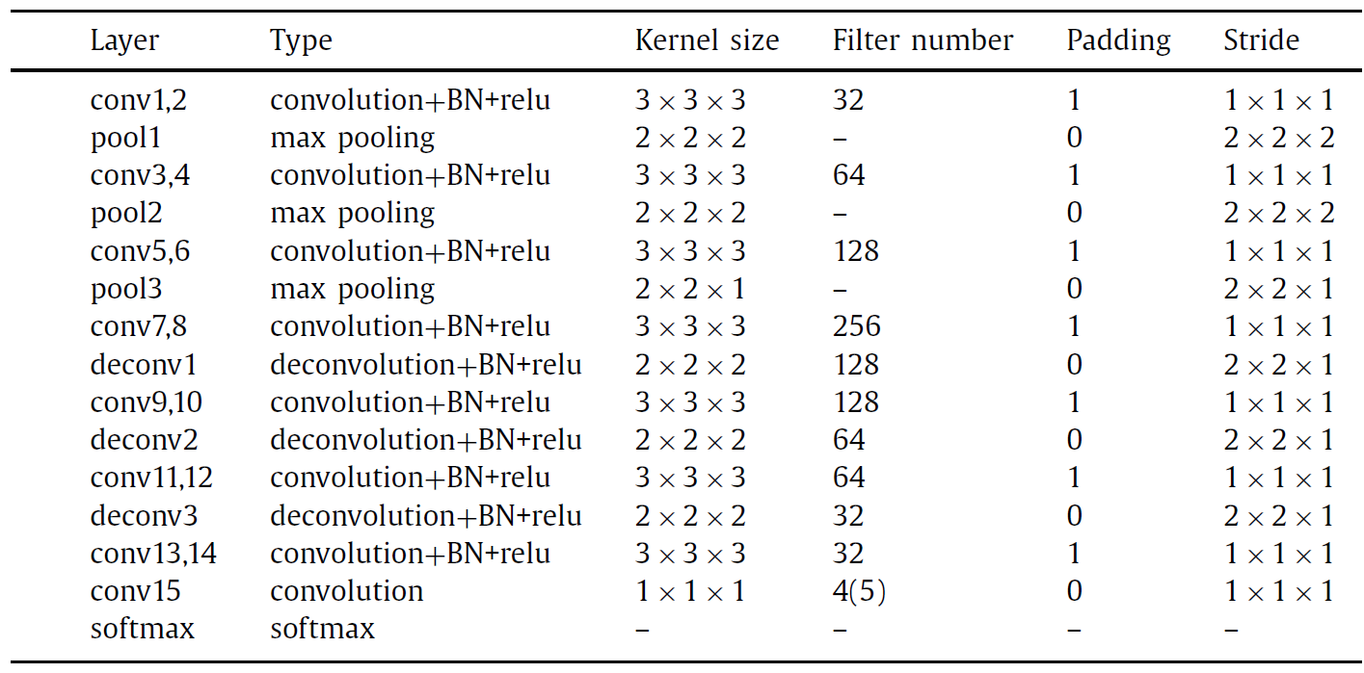
U-Net
Important model parameters of 3D U-Net adopted in this paper. Filter number in the last convolu- tional layer depends on the number of normal and tumor classes, i.e., 4 (BRATS 2017) or 5 (BRATS 2015) in this paper.

Slide 10
DF-MLDeepMedic
The auxiliary loss function is attached to the ‘Conv8’ layer of the full-resolution pathway. For the two-pathway DF-MLDeepMedic, there is another auxiliary loss function attached to the deconvolutional layer of the low-resolution pathway.

Slide 11
DF-U-Net
A new convolutional classification layer and the auxiliary loss function is attached to the ‘Conv8’ layer.

Slide 12
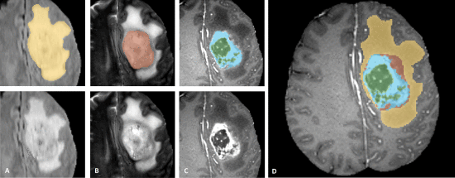
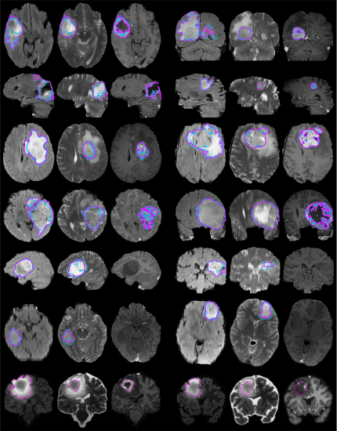
Experiments
Data:
  two brain tumor segmentation datasets:
    BRATS 2015
      274 3D MRI scans
      4 classes of tumor tissues:
        necrotic, edema, non-enhancing tumor, and enhancing tumor
    BRATS 2017
      285 3D MRI scans
      3 classes of tumor tissues:
        necrotic, edema, and enhancing tumor
    Image Size: 240 × 240 × 155
    Train: 255 images
    Validation: 30 images

Slide 13
Experiments
Implementation details
  open-source deep learning package C3D
  Batch size: 64
  Learning rate: 0.001
  maximum number of iterations: 40 epochs

Slide 14
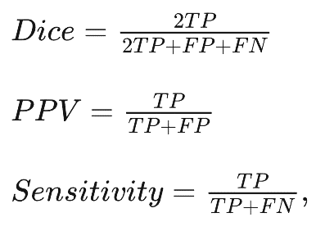
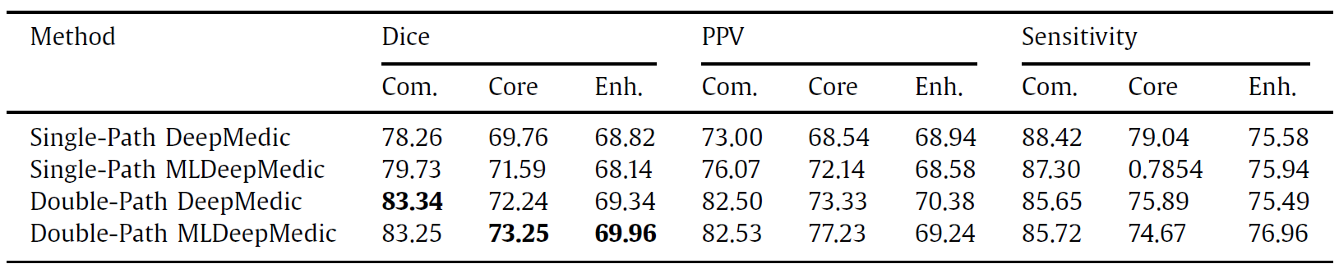
Experiments
Evaluation criteria
Performance comparison between DeepMedic and MLDeepMedic on the local validation subset of BRATS 2017 (%)

Slide 15
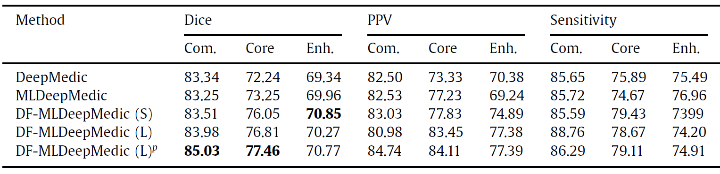
Experiments
Performance comparison between DeepMedic, MLDeepMedic, and DF-MLDeepMedic on the local validation subet of BRATS 2017 (%).

Slide 16
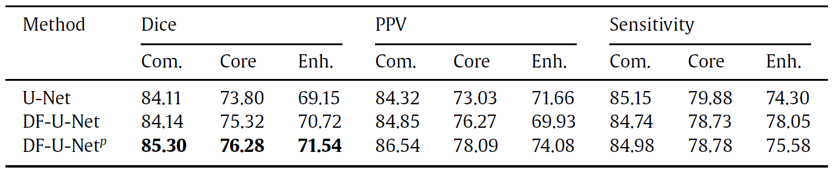
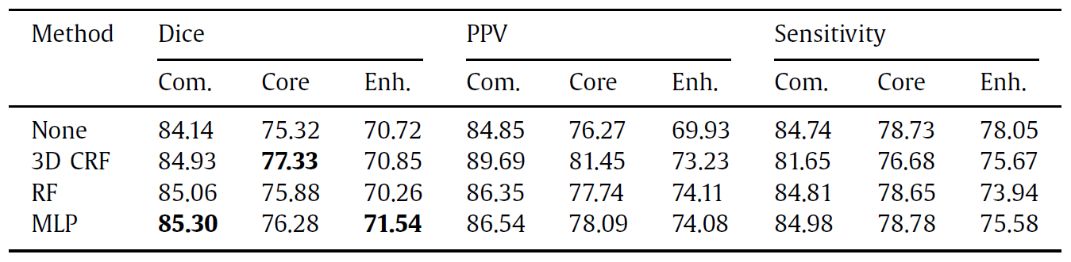
Experiments
Performance comparison between U-Net and DF-U-Net on the local validation subset of BRATS 2017 (%).
Performance Comparison of Different Post-Processing Methods on Local Validation Dataset of BRATS 2017 (%).

Slide 17
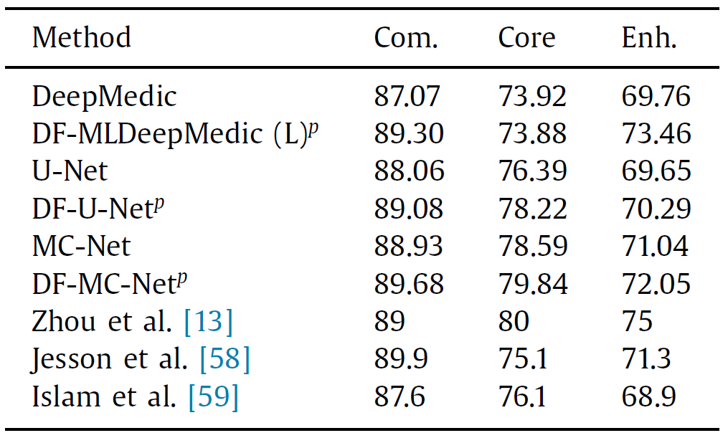
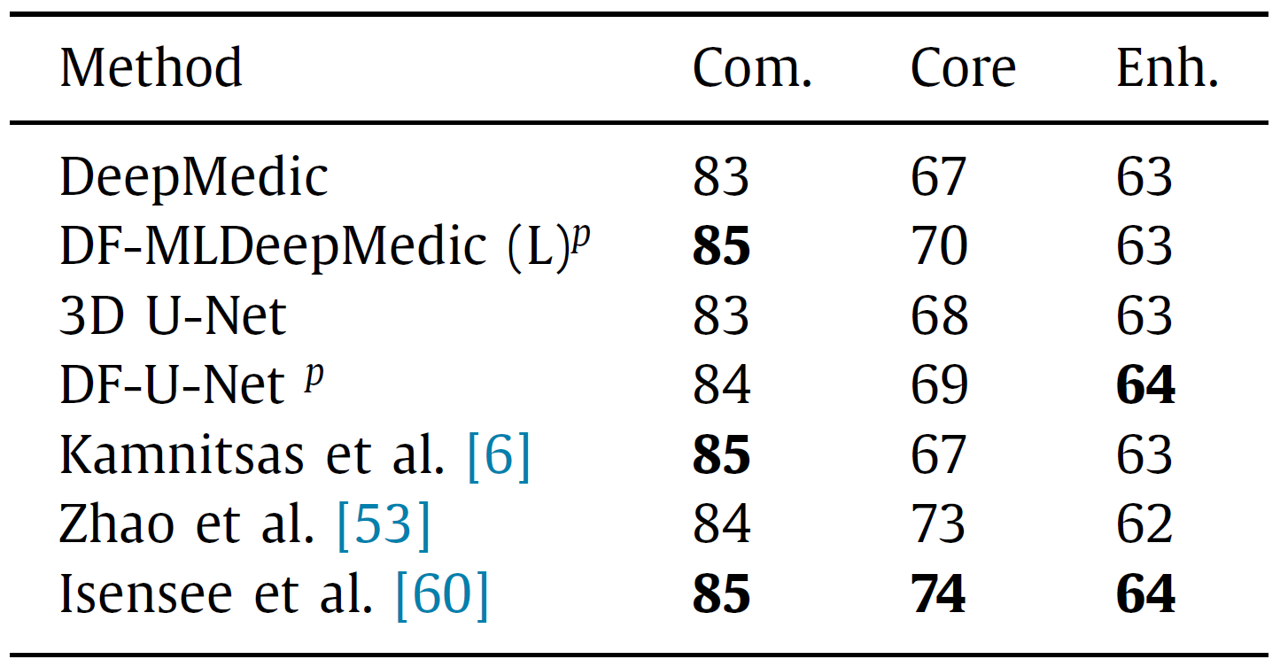
Experiments
Comparison of Dice scores between DFNs and the state-of-the-art methods on BRATS 2017 Online Validation Dataset (%).
Comparison of Dice scores between DFNs and the state-of-the-art methods on the BRATS 2015 online test dataset (%).

Slide 18
Experiments
Columns:
  original MRI slices
  ground-truth segmentation
  DeepMedic
  MLDeepMedic
  DF-MLDeepMedic (S)
  DF-MLDeepMedic (L)
Colors:
  Edema (green)
  enhancing tumor (red)
  necrosis and non-enhancing tumor (blue)
1
2
3
4
5
6

Slide 19
Conclusion
Accurate brain tumor segmentation depends on multi-level information
a dual-force training strategy is proposed to explicitly encourage deep models to learn high-quality multi-level features by a label distribution-based loss function to learn the abstract semantic information and a softmax loss function for segmentation using multi-level features
Applying the proposed strategy to deep models only slightly increases the time and space complexity while training
an MLP-based post-processing method is also proposed that can automatically learn post-processing rules from data rather than manual summarization
One shortage of the MLP-based post processing method is that its training process is separated from that of DFN; therefore, the entire framework is not completely end-to-end

